Slide 1
Group 14
Cryptocurrency
Information Site
March 4, 2018
Zixiang Wang
Miguel Twahirwa
Xin Qiu

Slide 2
AGENDA
Vision
Problem
Approach / Solution
Market
Competition
Demo

Slide 3
VISION
Provide customers with concise cryptocurrency information.

Slide 4
PROBLEM (CUSTOMER PAIN)
What is the customer pain point?
Customers have to check multiple websites of different exchanges to get the price information for different cryptocurrency.
What is the current solution for this pain?
For a specific type of cryptocurrency, integrate its price information across different exchanges and show the result in one chart, which makes it easier for comparison.

Slide 5
SOLUTION / PRODUCT
Explain your product:
Our site has three main functions.
1. Show the up-to-date overall cryptocurrency market information in a chart and a market capital comparison graph.
2. For a specific cryptocurrency, show the price information across the top 10 markets of volume to help with purchasing decision making.
3. Show the top 10 hot tweets to let customers know what people are discussing about cryptocurrency as well as a heap map showing the regions they are mostly being discussed.

Slide 6
MARKET
What are the market forces / drivers?
Investors and traders in cryptocurrency need to access accurate information faster and make investing/trading decisions easier.
Describe your market / target customer, and demonstrate the impact on your customer:
Our site will save a lot of time for potential cryptocurrency buyers as well as existing traders who want to check the overall situation of the market, and the price information for a specific coin.

Slide 7
COMPETITION
Frame the competition—who are the key players, how are you differentiated?
Key players include other integrated cryptocurrency information sites. Different from those sites which only provide a bunch of price information, we integrated Twitter API to show the impact of social media.

Slide 8
Demo
Links to Jupyter Notebooks:
Web Scraping Part:
https://github.com/95880-A3-SP18/web-analytics-group-14/blob/master/ProjectCode/Project_ScrapePart.ipynb
Twitter API Part:
https://github.com/95880-A3-SP18/web-analytics-group-14/blob/master/ProjectCode/Twitter%20API%20dashboaord%20.ipynb

Slide 9
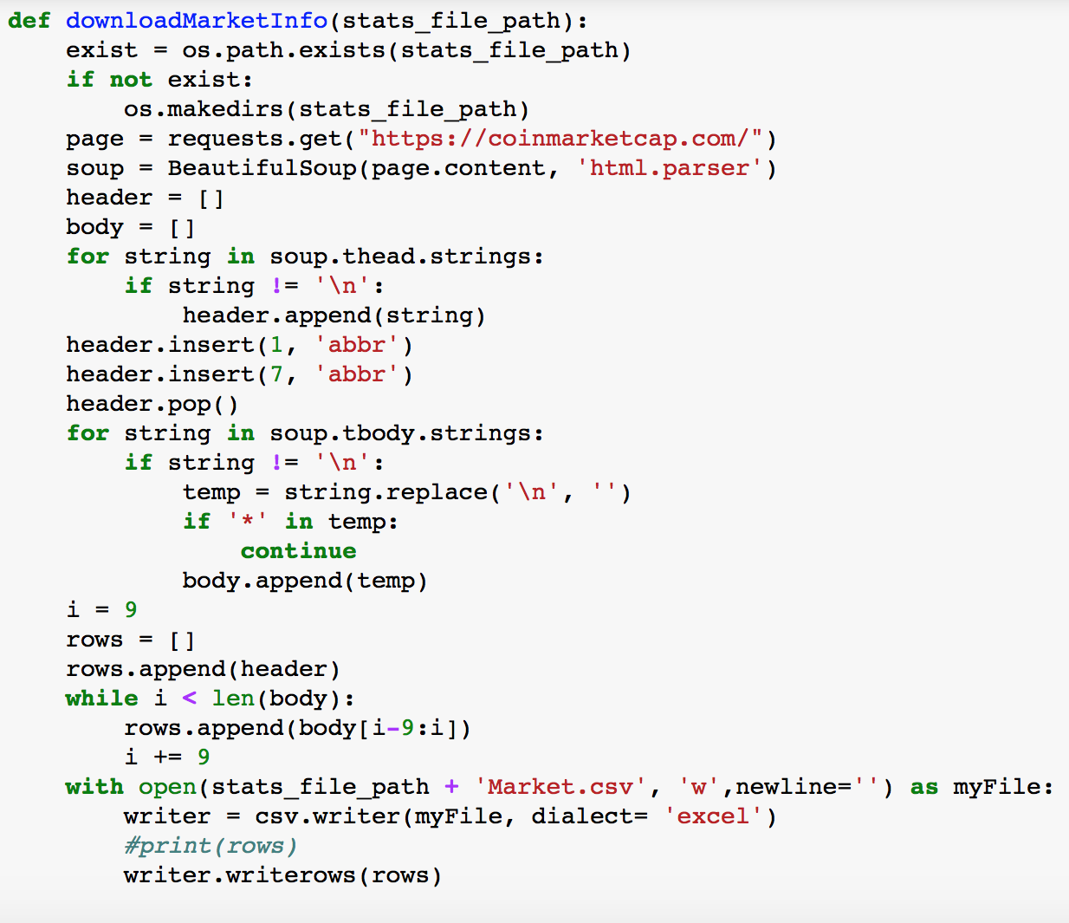
Demo
Scrape General Market Cap Information

Slide 10
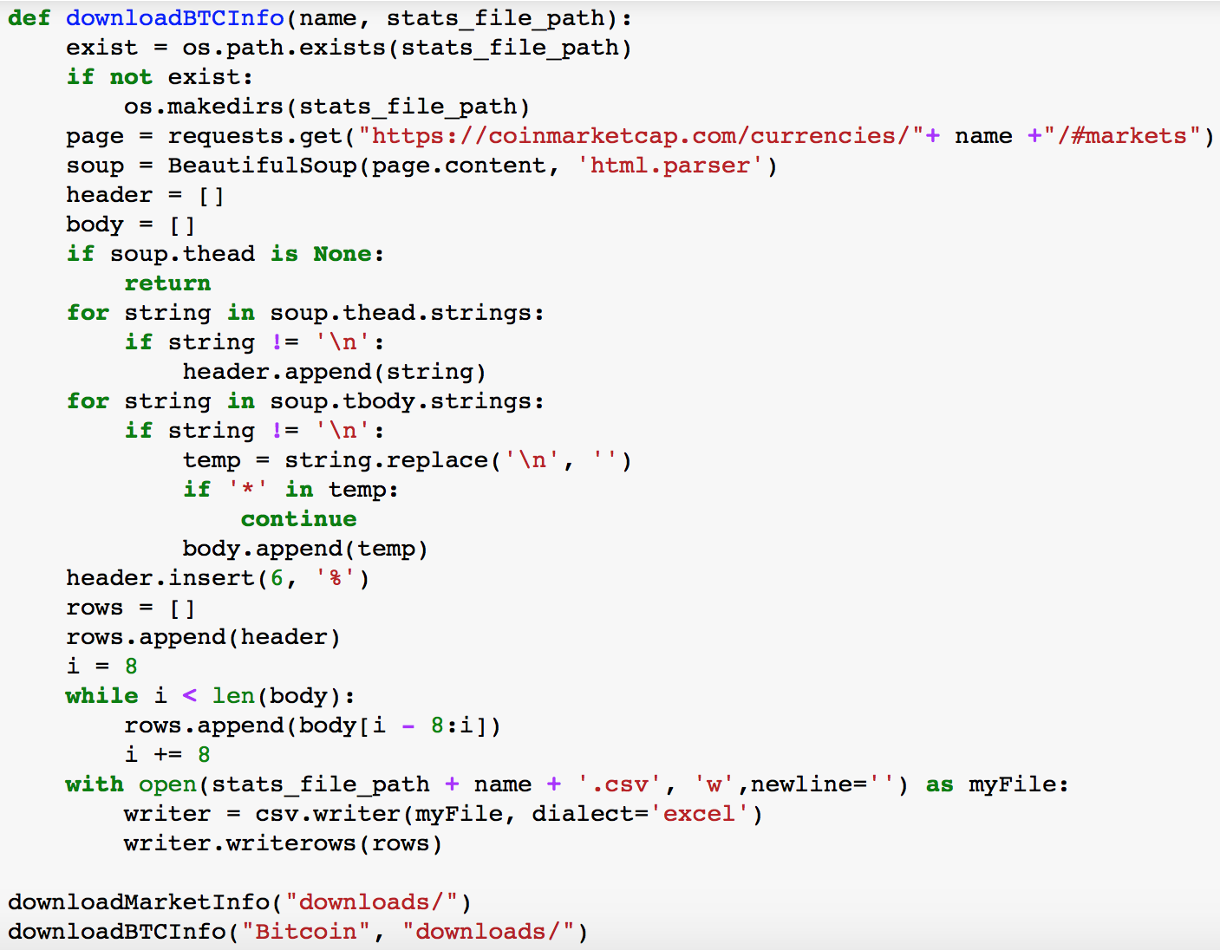
Demo
Scrape Price Information of a specific coin
(Bitcoin as a example)

Slide 11
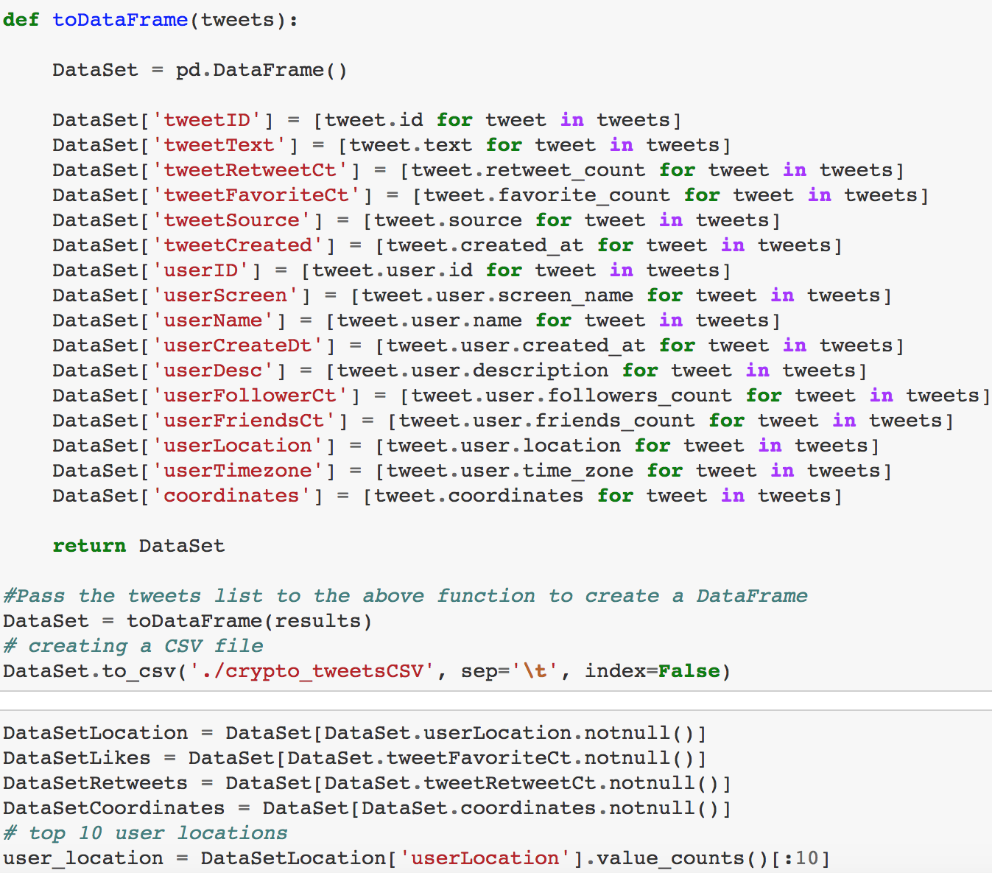
Demo
Twitter Analytics:
Top 10 areas generating tweets about #Bitcoin, #Ripple, #Litecoin, #Crypto

Slide 12
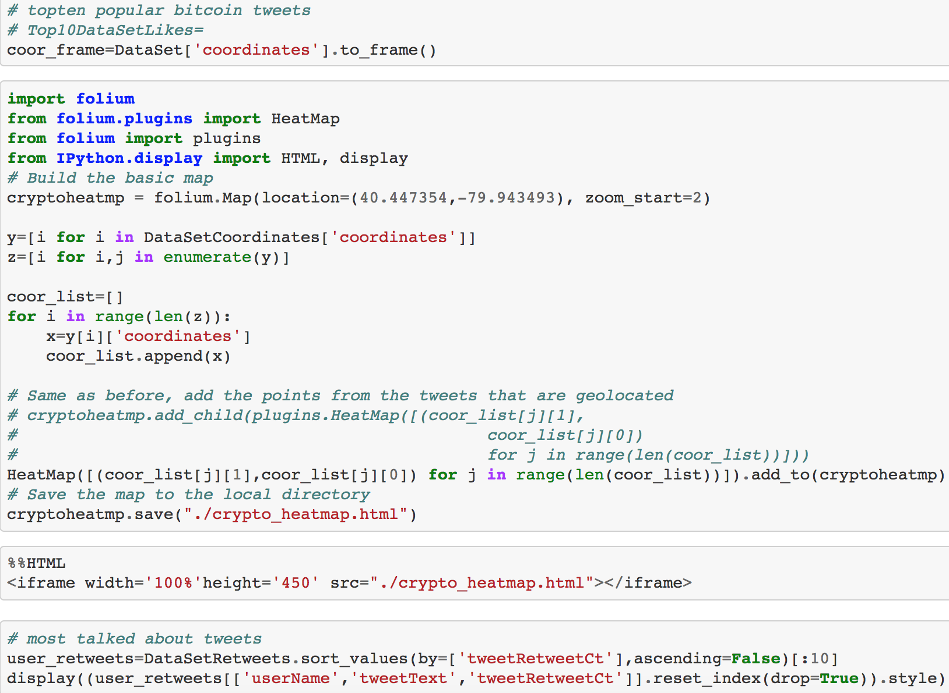
Demo
Select top 10 tweets that are most talked about

Slide 13

Demo
Website Demo
(open the website to show how it works)

Slide 14
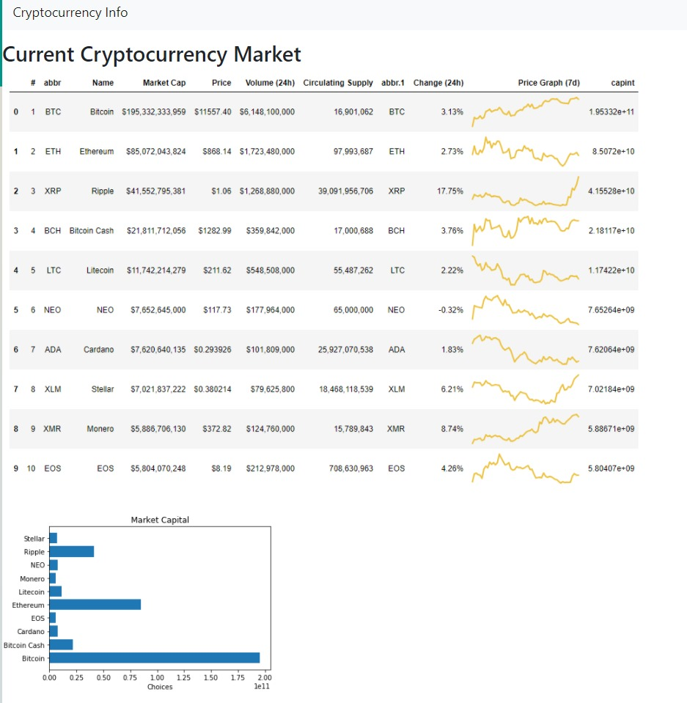
Demo
Show Overall Information about the Cryptocurrency Market

Slide 15
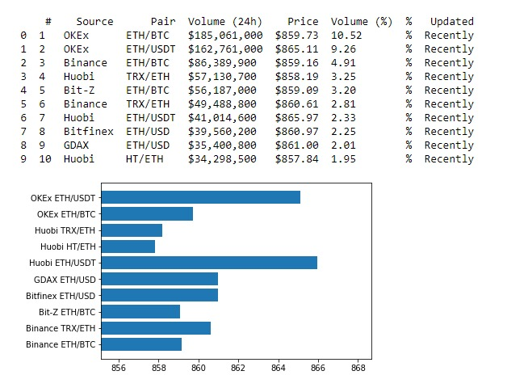
Demo
Show Price Information of
a specific coin
(Bitcoin as a example)

Slide 16
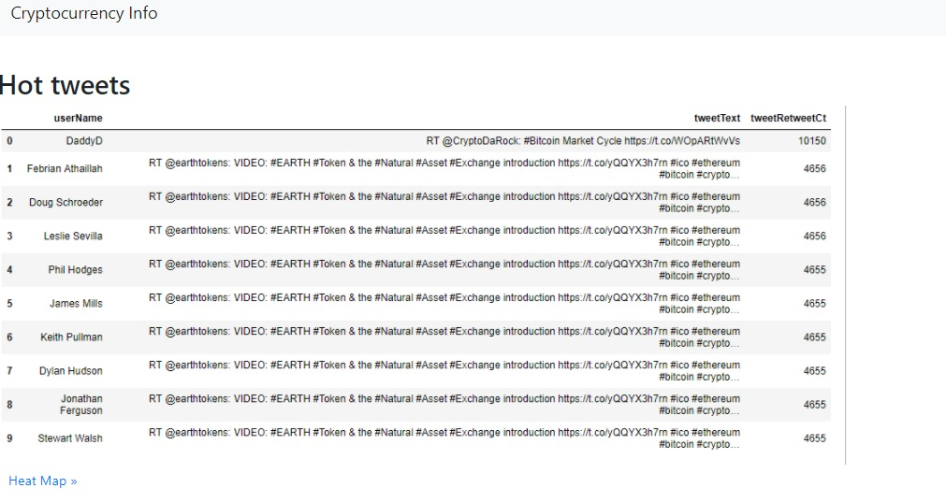
Demo
Show top 10 tweets that are most talked about

Slide 17
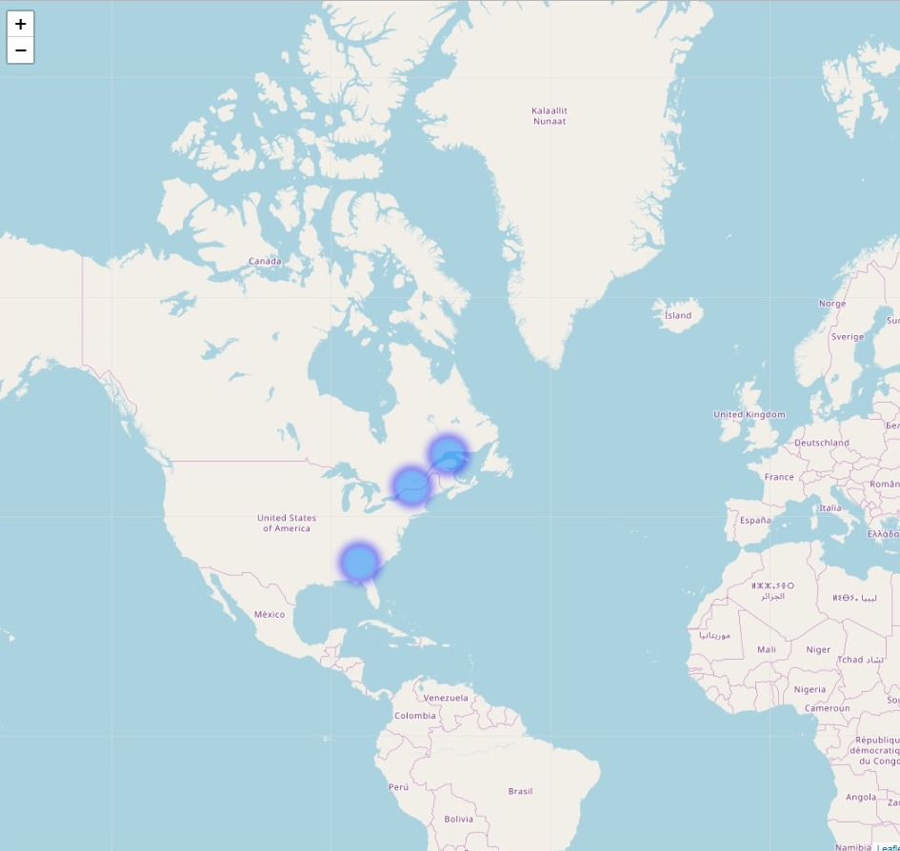
Demo
Show a Heat map

Slide 18
Thank you !

